Slide 1
Line Art
Mission 14

Slide 2

Pre-Mission Preparation
In this mission you will discover the magic of computer graphics. You will use loops to create beautiful and interesting art.
In previous missions, you learned how to draw with lines, circles and rectangles. How do you think you can use loops to create art?

Slide 3
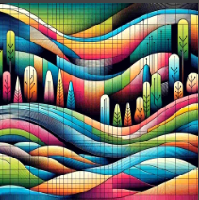
Mission 14: Digital Artistry
This mission will lead you on a journey to discover the magic of computer graphics.
You will make beautiful visual art with just a few lines of code.
Pixel Power
It all starts with a pixel drawn on the screen. But as you’ve seen, things get much more interesting when you loop your code to create patterns of logic, sounds and light!

Slide 4
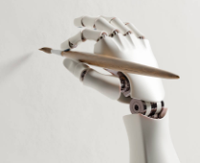
Mission 14: Digital Artistry
for the Win!
As you complete this mission you will gain a mastery of the for loop, a versatile tool to have in your coding toolbox.
Ready to visualize a range of colorful pixels streaming across your LCD screen?

Slide 5
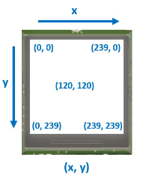
Objective #1: Pixel Power
You have already drawn on the screen using bitmap functions.
display.draw_rect()
display.draw_text()
display.draw_circle()
display.draw_line()

Slide 6
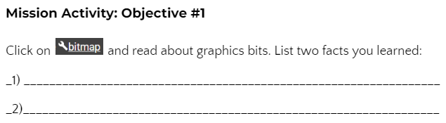
Mission Activity #1
DO THIS:
Click on
Then go to your Mission Log Objective 1 and write down two facts about Bitmaps.

Slide 7

Objective #1: Pixel Power
Another basic graphic is the single pixel, which other shapes are made from:
The CodeX LCD screen contains 240x240 pixels.
240 pixels from left to right: x = 0 to 239
240 pixels from top to bottom: y = 0 to 239

Slide 8

Objective #1: Pixel Power
Setting Pixels
You can set (or draw) a pixel anywhere on the screen.
This code draws a YELLOW pixel at x=120 and y=120:

Slide 9
Mission Activity #1
DO THIS:
Create a new file named PixelPlay
Type in the code below.
Then draw 6 more pixels at different locations on the screen with different colors.
Guess where they should appear before running the code.
Are they where you expected them to be?
Run the code.

Slide 10
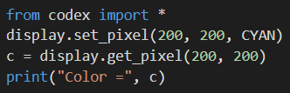
Objective #1: Pixel Power
Reading Pixels
Your code can write pixel colors to the display, but it can also read them back!
The following code sets a pixel on the screen, and then reads the tuple of the color.

Slide 11


Mission Activity #1
DO THIS:
Open the Console
Type in the 4 lines of code directly into the Console (not your program)
You know from working with RGB colors that CYAN is (0, 255, 255). Is this the tuple that was printed?
Go to your Mission Log and write down the tuple value of c.
Then you can close the Console

Slide 12

Pixel Basics
During this mission you have learned about setting and getting pixels.
Answer 2 quiz questions about the concept.
CODEX
QUIZ

Slide 13


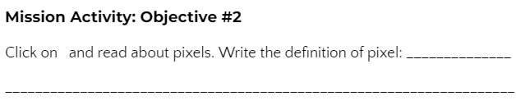
Mission Activity #2
DO THIS:
Click on to add it to your toolbox.
Then go to your Mission Log Objective 2 and write down the definition of “pixel”.

Slide 14
Objective #2: Line Up!
Now that you have mastered pixels …
Seriously, you pretty much know all there is to know about them!
Line Up! What do you call a bunch of pixels in a row?
Wait for it ….. A LINE!
So what are you waiting for?
The LCD is 240 pixels wide.
Just copy and paste display.set_pixel() 240 times, right?
Don’t you dare! That is what loops are made for!

Slide 15
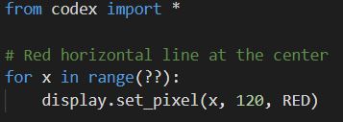
Mission Activity #2
DO THIS:
Delete ALL the set_pixel() commands. Replace them with a loop.
A single lovely for loop is all you need to achieve the goal!
Replace ?? with the number needed to go all the way across the screen.
Hint: the range of x is the width of the screen.
Run the code.

Slide 16
Objective #3: Two Axes to Grind
Add a Vertical Axes
You have a nice horizontal line. Adding a vertical line to match will create a perfect reference for drawing additional line art.
Getting Centered
Your code currently uses “magic numbers” like 240 for the display width, and 120 for the center.

Slide 17
Objective #3: Two Axes to Grind
What is a “magic number”?
A number that just appears in code with no explanation.
Other programmers may have no idea what they mean.
And if something changes, like a size, the number won’t work and must be changed.
You can eliminate a magic number by using a variable or constant instead.

Slide 18

Objective #3: Two Axes to Grind
Avoiding a “magic number”
Python has a function that can tell you the display width and height.
Use the function as the range in the for loop.
Use the functions to define x_center and y_center.
Then use the variables in the display.set_pixel() functions.

Slide 19
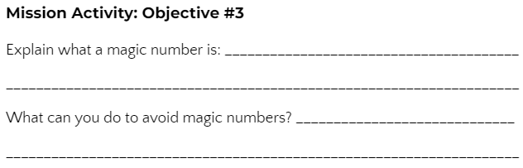
Mission Activity #3
DO THIS:
Go to your Mission Log and complete the questions for Objective #3

Slide 20
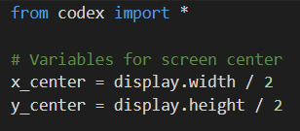
Mission Activity #3
DO THIS:
Assign variables for the center of the screen.
Use display.width and display.height
Just divide the width and height in half!

Slide 21

Mission Activity #3
DO THIS:
Modify the for loop to use display.width and y_center

Slide 22

Mission Activity #3
DO THIS:
Add a new for loop just like the first one, but for a vertical line.
Use y and display.height for the range.
Use x_center in the display function.
Run the code. You WILL get an ERROR!

Slide 23

Objective #4: Bug Fix
Variables used for a location, like x and y must be integers, or data type int
You don’t always know something until you try it!
Then, you can just fix the bug.
Be fearless – try stuff!
You can eliminate the error by converting the division problem to an integer, or data type int.

Slide 24
Objective #4: Bug Fix
When you use division (/), the answer is automatically a float, or decimal number.
display.width / 2 = 120.0
This is a float!
We need 120, not 120.0
Use the conversion function int() to convert it to an integer!

Slide 25

Mission Activity #4 - CodeTrek
DO THIS:
Fix the bug by converting the x_center and y_center variables to integers
Run the code.
<continued>

Slide 26
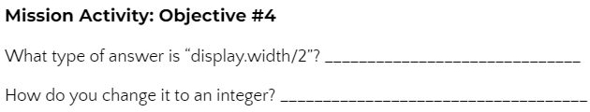
Mission Activity #4
DO THIS:
Go to your Mission Log and complete the question for Objective #4

Slide 27
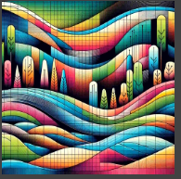
Objective #5: Graphical Grid
The X and Y axes (horizontal and vertical lines) will help with symmetry and balance as you create artistic designs.
But it is still difficult to judge scale at a glance.
Creating a grid of dots can help to clearly see pixel spacing over the whole screen.

Slide 28

Objective #5: Graphical Grid
Dot dot dot …
You want to create a grid of dots. Each “dot” is just a single pixel.
You can draw a line of white dots, only showing every 10th pixel, by using a step in the for loop.
Go ahead – try it!
Change the step and run again, to see what happens.

Slide 29
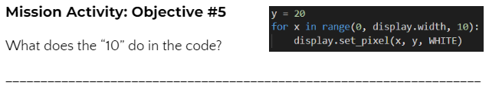
Mission Activity #5
DO THIS:
Go to your Mission Log and complete the question for Objective #5

Slide 30
Objective #5: Graphical Grid
Notice how the step parameter of range(start, stop, step) advances x by 10 every loop.
Enter the Matrix: You will need more than a single line of dots to complete the objective.
A grid that covers the whole screen!
This is a bunch of lines, drawn top to bottom.

Slide 31
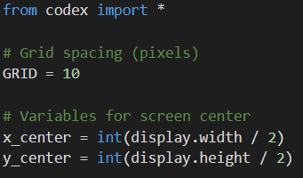
Mission Activity #5
DO THIS:
No magic numbers!
Define a CONSTANT for the step parameter (grid spacing)

Slide 32
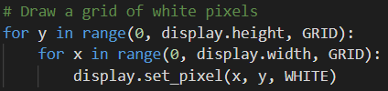
Mission Activity #5
DO THIS:
Use two loops – an inner and outer loop – to draw the grid
The inner loop draws a single horizontal line
The outer loop repeats the horizontal line down the height of the screen
NOTE: If you have the code in your program from slide 28 (experimenting with step) you can delete it first.
Run the code.

Slide 33
Graphics Ranger
During this mission you have learned about the drawing pixels on the screen using loops.
Answer 2 quiz questions about nested for loops.
CODEX
QUIZ

Slide 34
Objective #6: Keep It Simple
You have transformed your screen into a fantastic canvas for graphical artistry!
But before you move on, you should neaten it up a bit.
Line Drawing Function
Drawing a line pixel by pixel is awesome, but CodeX has a built-in function that draws a line faster and simpler
And it can do diagonal lines, too!

Slide 35

Objective #6: Keep It Simple
Simplify your code by replacing the for loops with display.draw_line().
The built-in function looks like this:
It requires the starting location (x1, y1) and the ending location (x2, y2) and the color.

Slide 36
Objective #6: Keep It Simple
Think about the horizontal and vertical lines in your code right now, drawn with for loops and pixels.
What would the starting and ending locations be for each line?
Horizontal line: x goes from 0 to display.width, y is at y_center
Vertical line: y goes from 0 to display.height, x is at x_center
What would the commands look like to draw the two lines?

Slide 37
Objective #6: Keep It Simple
Frame it Up!
You can also draw a blue box around the edges to create a border for your art. You used display.draw_rect() several times in Mission 13.
What would the starting location be for the box?
Do you think x and y start at (0, 0)
What are the width and height of the box?
Would you use display.width and display.height?

Slide 38
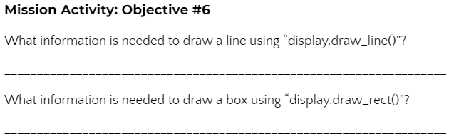
Mission Activity #6
DO THIS:
Go to your Mission Log and complete the questions for Objective #6

Slide 39
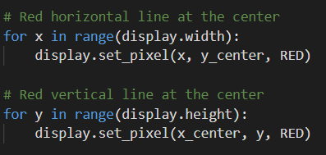
Mission Activity #6
DO THIS:
Save to a New File!
Use the File → Save As menu to create a new file called LineArt
In your new LineArt file, delete the code that drew the red horizontal and vertical lines.

Slide 40
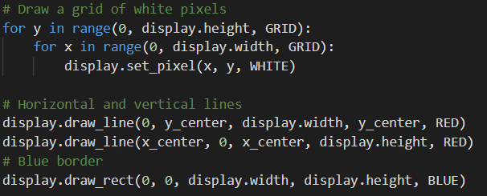
Mission Activity #6
DO THIS:
Draw the horizontal and vertical lines using display.draw_line()
Draw a border box using display.draw_rect()
Run the code.

Slide 41
Objective #7: Get Artistic!
You are working with straight lines. How artistic can you get?
Well, you might be surprised!
Straight lines can get downright curvy!
Look at the graphic in CodeSpace Objective 7.
Notice as Y moves down, X moves to the right!
Remember – on CodeX, y values increase when going down!

Slide 42
Objective #7: Get Artistic!
Whoa! String Art :-)
Watch the animation in CodeSpace Objective 7. The lines make a curve. That is called an envelope.
Click this link to learn more about envelopes in geometry. You don’t need to understand the math! Scroll through the page and look at some of the string art examples.

Slide 43
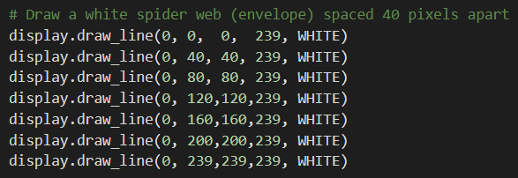
Mission Activity #7
DO THIS:
Draw several lines to create some line art (after the border.
Notice the start x is always 0, and the ending y is always 239.
Increasing the start y and ending x is how you slide the line down the screen.

Slide 44
Mission Activity #7
DO THIS:
The spacing inside the parameters is for clarity and doesn’t impact the run.
With all this repetition, you are probably thinking … shouldn’t we use a loop?
The answer is YES. We will do that next. For this objective, type in all the lines.
Run the code.

Slide 45
Objective #8: Automate Your Art
Hey, that is a pretty cool display!
But it would be nice to automate some of those “magic numbers” and reduce the lines of code
The web follows this pattern:
First line starts at (0, 0) and ends at (0, 239)
The next line moves y down (+40) –and– moves x across (+40)
Then repeat the y+40 and x+40 many times

Slide 46
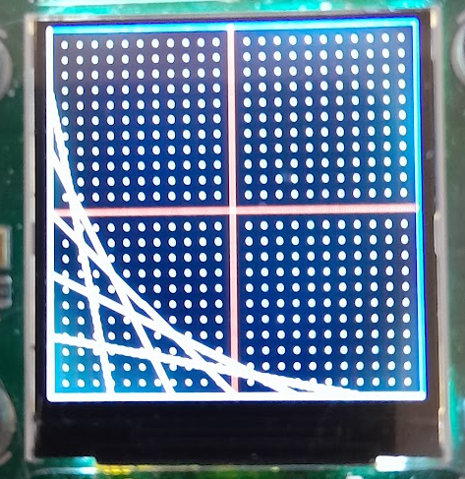
Objective #8: Automate Your Art
It may help to track the lines with your fingers.
Use your left finger for the start of the line.
Use your right finger for the end of the line.
Start with the first line (it is vertical against the border)
Follow each line by moving down (left) and over (right)

Slide 47

Objective #8: Automate Your Art
Now try doing the webbing with a for loop.
Did you notice that the middle two numbers (start y and end x) were always the same? You can use a variable for that.
The numbers increase by 40, so use that as your step parameter. Your loop could look like this:

Slide 48
Mission Activity #8
DO THIS:
Delete ALL the lines of code that draw the white webbing.

Slide 49
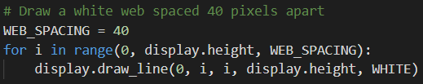
Mission Activity #8
DO THIS:
To avoid a magic number, define a constant for WEB_SPACING and use display.height or display.width when needed.
Replace the code with a for loop
Run the code.

Slide 50
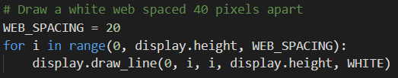
Mission Activity #8
DO THIS:
Change the value of WEB_SPACING to something less than 40.
Run the code again and see what happens.

Slide 51
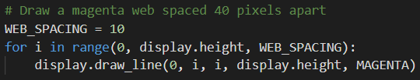
Objective #9: A Splash of Color!
Take some time to experiment with the code you have now.
Art is all about experimentation and creativity!
Try changing the color:

Slide 52

Objective #9: A Splash of Color!
Add to your code by going from lower left to upper right:

Slide 53
Objective #9: A Splash of Color!
Is your brain hurting yet?
It can be a little mind-bending trying to work out how to sweep lines across the screen just the way you want to.
We can simplify the approach!
Create a function that draws webbing.
It will use variables for “delta”, which means “change”

Slide 54
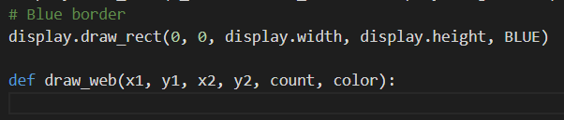
Mission Activity #9
DO THIS:
Create a function that will draw a web.
It is very similar to display.draw_line() but uses one more parameter, count.
Count is the number of lines it will draw.
The function can go under the grid and border.

Slide 55
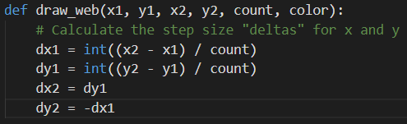
Mission Activity #9
DO THIS:
Calculate the changes in the x and y locations.
This is a lot of math! Don’t worry about it if it doesn’t make sense.
Just know that a delta is a small change, and this math does all the work.

Slide 56
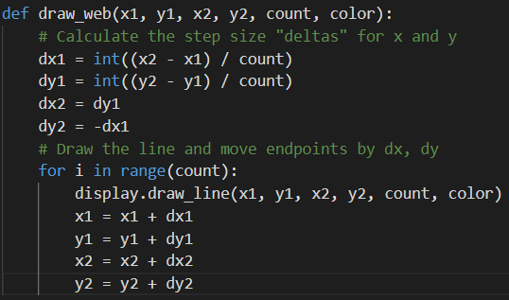
Mission Activity #9
DO THIS:
Now use your values to draw a line, and make the changes for the next line.

Slide 57

Mission Activity #9
DO THIS:
First delete the for loop that draws the MAGENTA web.
Replace the code by calling the function.

Slide 58
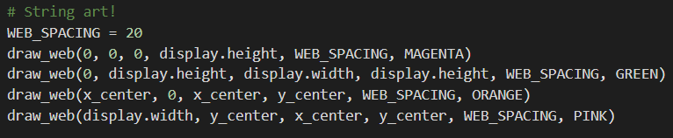
Mission Activity #9
DO THIS:
Now delete the code for the GREEN webbing.
Replace the code by calling the function.

Slide 59
Mission Activity #9
DO THIS:
Draw two more webs:

Slide 60


Mission Activity #9
DO THIS:
Draw at least two more webs!
You can use your own creativity, or:
Try finishing the inner webs by filling in the ??
Try finishing the outer webs by filling in the ??
Think about where you want the first line to start
Think about where you want the last line to finish
Run the code.

Slide 61
Post-Mission Reflection
Read the “completed mission” message and click to complete the mission
Complete the Mission 14 Log

Slide 62
Clearing your CodeX
Go to FILE -- BROWSE FILES
Select the “Clear” file and open it
Run the program to clear the CodeX

